Slide 1
How to Write Your Introduction Paragraph & Conclusion

Slide 2
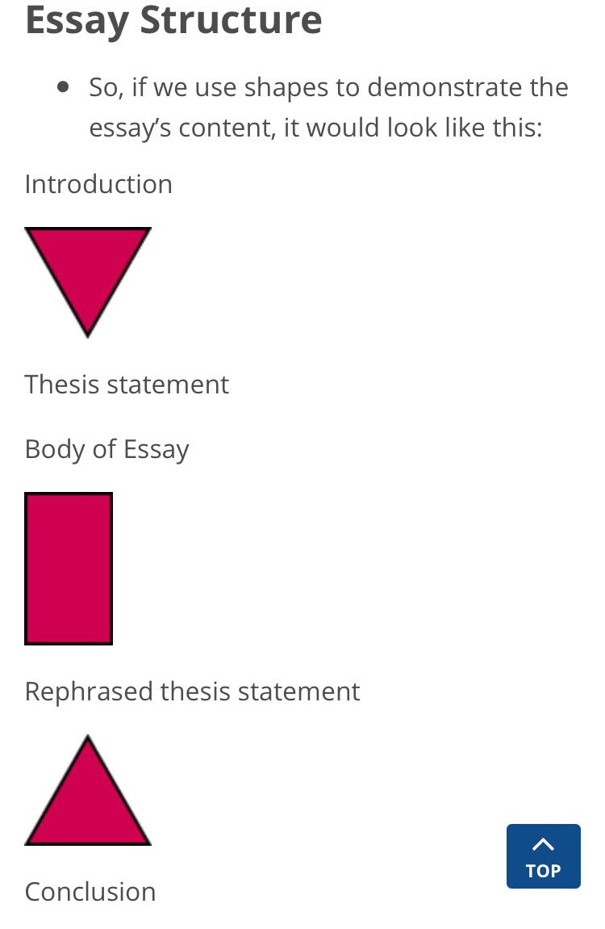
Writing Your Introduction
Step 1: Grab you readers attention with a general statement about your topic. This is the HOOK.
Step 2: Briefly explain in 2‐5 sentences what the essay will be about by providing relevant background information.
Step 3: End your introduction with a strong thesis statement that tells your reader what you intend to prove to him or her about your topic.

Slide 3


Step 1:
Hook Your Reader
Grab your reader’s attention
about the topic.
1. Questioning
2. Interesting Fact
3. Anecdote

Slide 4
Question Hook
A question hook is when you ask the reader something that they can visualize and try to think of in their own minds. Then, the writer answers the question.
Example
Have you ever watched the high-flying, jump shooting, slam dunking, ankle breaking players that play in the NBA? Every time I catch a game on television and I witness the thrill of the game, I can’t help but watch another one.

Slide 5
What’s body image? Itis how people picture themselves and how they think other people picture them. It is basically how you feel about your body, and it includes your perception, imagination, emotions, and physical sensations. Mass media has been able to shape popular culture and often influence public opinion. However, the body images projected by social media have affected teens with physical problems, low self-esteem, and depression

Slide 6
Interesting fact or statistic
can be used for more informational pieces of writing. The writer may use a quote from a source that relates to the main idea of the essay, that includes some statistics, such as numbers, decimals, or and/or percentages. The meaning and relationship of the quote to the essay needs to be explained afterwards just in case the reader does not quite understand
“Just 0.00545 percent of the 550,000 boys playing high school basketball each year in the United States become a first-round draft pick — 1 in 18,333” stated Jeff Rabjohns, a writer for The Indianapolis Star, in an article titled “Prep players face long odds of making it to NBA.” Basically, only a few high school players will make it to the NBA. Even though there are many that strive, play, train, practice, and fight to be great, a huge majority of them do not make it.

Slide 7
CO2 output is measured in pounds, and the average emissions per person in the United States, according to the U.S. Environmental Protection Agency, is 20,750 pounds per year [source: EPA]. Of course, everyone is different. But whether you're above, below or at that average, it's still possible to reduce your technology carbon footprint, and many people are taking steps to reduce. Everyone can reduce their carbon footprint by regulating the use of electricity at home, commute alternatives and investing in sources of renewable energy.

Slide 8
Anecdote
When a writer uses a short story to relate to the topic and gain the reader’s attention, they are using an anecdote. This story can be a short, personal story or one that is a figment of your imagination. Make sure that it relates to the main idea of the paper. Show the relevance that it has to the topic of the paper.
Example
When I was in high school, I remember playing in an AAU basketball league. We had to travel to downtown Philadelphia on the weekends for basketball practice. Each and every time we had basketball practice (which was at 8 a.m.), there was a boy around my age in the gym by the time we arrived. He was always covered in sweat, throwing up shots, practicing his layups, practicing his dribbling, and running laps around the gym. He was in such great shape. One day, I mustered up the courage to ask his about his ambitions, and he told me that he gets up at 5:30 a.m. to go to the gym and practice hard until my team comes in for practice. A few years later, this guy was entering the NBA draft from high school. When I saw him get drafted by the Philadelphia 76ers, I knew exactly why. All that hard work had paid off for him. This is the hard work ethics and mindset that everyone that wants to make it to the NBA should have.

Slide 9
Anecdotes
Three weeks into training camp, I still hadn’t gotten used to Navy cooking and was surviving on milk and desserts. In one food line, I picked up the biggest piece of cake available and set it on my tray. The mess cook behind the counter saw the gleam in my eye and asked me if I’d like two pieces. When I eagerly answered that I would, the cook leaned over and cut my piece of cake in two.
Travelling in France, I ordered lunch in French, relying on my translation dictionary. Seemingly impressed, the waiter smiled as he thumbed through a few pages of my book. Later, when I paid my bill, I motioned him to wait while I scanned my guide for a comment appropriate for the wonderful meal. He pointed to a French phrase. The translation: “Keep the change.”
Two hunters are out in the woods when one of them collapses. He’s not breathing and his eyes are glazed. The other guy whips out his cell phone and calls 911. “I think my friend is dead!” he yells. “What can I do?” The operator says, “Calm down. First, let’s make sure he’s dead.” There’s a silence, then a shot. Back on the phone, the guy says, “OK, now what?”

Slide 10
Sitting against the backdrop of stars, I then noticed the boats gently drifting on the ocean, taking me back through the tides of time to my childhood. These boats reminded me of my own boating trips with my grandfather and my next door neighbor. During fishing trips we took every three weeks, my grandfather continually talked about customers and sales from his business, introducing me to the world of economics and finance. The beach has always held a special place in my heart. I love to spend time at the beach because I reminds me of my childhood , helps disconnects from the busy city life and meditate in peace.

Slide 11
Last year there was a huge commotion created about a student that committed suicide. All that could be gleaned from the facts was that the student was under a lot of pressure to perform well in the final exams, unable to cope with the pressure she jumped of the roof of the building leaving the students and faculty shocked. Why would anyone take their life if they are unprepared for their exams? The dearth of mental illness awareness is increasingly seen as a contributing factor in the rise in suicide cases . In Pakistan, awareness of mental health problems due to social taboos, absence of support and professional help is severely lacking.

Slide 12
Step 2: Explain What You Are Talking About
Lead-in-to :
Briefly explain in 2-5 sentences what the essay will be

Slide 13
Step 3: Write Your Thesis Statement
A thesis statement is in many ways the most important sentence that you will write in any paper. It is like a blueprint or foundation to your essay
– it helps you (and the reader!) stay focused: - gives the main idea of the entire essay
- suggests the topic for each body paragraph (for short or 5- paragraph essays)
- commonly has three parts (for 5-paragraph essays) that are parallel in structure
- avoids 1st person expressions like “I’m going to talk about…” - the supporting points should be logically connected to your thesis or argument
Example: To become a more inviting campus, Gainesville State College, offer student housing, and offer childcare.

Slide 14
Things to AVOID
You should avoid using statements like, “This essay will discuss…” or “I’m going to write about…”.
Incorrect : In this essay, I am going to discuss the effects of long-term drug abuse.
Correct : Long-term drug use can have disastrous effects on one’s marriage, career, and health.

Slide 15

Model Introduction Paragraph
Smoking‐related diseases
cause an estimated 440,000
American deaths each year.
Even with facts like these, the
entire country is divided on this
issue. Some people believe that
smoking should be banned
everywhere while others are not
so harsh. However,
tobacco should be outlawed because smoking endangers everyone’s health, pollutes the environment, and drains us of valuable energy.
Hook
(Interesting Fact)
Brief Explanation
(Leads into thesis)
Thesis
(What you will be proving)

Slide 16


Another Model Introduction Paragraph
Have you ever noticed that Athens is a popular name for cities? All cities that are named Athens are named after the Greek goddess Athena. The daughter of Zeus, Athena is the goddess of wisdom, just wars, and architecture. She is the best all-around Greek mythology character because she is very wise, a great tactician, and she only helps fight justified wars.
Hook
(Thought-provoking question)
Brief Explanation
(Leads into thesis)
Thesis
(What you will be proving)

Slide 17
Another Model Introduction Paragraph
Imagine the jungle surrounds you and one of the most talented hunters in the world is pursuing you; would you stand your ground? In Richard Connell’s short story “The Most Dangerous Game,” that is exactly what Rainsford does. Stranded on Ship trap Island, Rainsford must play hunter General Zaroff’s game, where Zaroff tries to hunt Rainsford down like an animal. Rainsford is one of the bravest characters in literature because he is not easily frightened, he jumps into the sea, and he defeats Zaroff by outsmarting him.
Hook
Brief Explanation
(Leads into thesis)
Thesis
(What you will be proving)

Slide 18
Conclusions
Conclusions are in many ways similar to introductions: they do not present new relevant information.
Conclusions have two components:
1. A final analysis or interpretation of the paper.
Either restate your thesis or sum up the general meaning of your overall argument, explanation, or description.
2. An ending comment, such as an interesting idea or your personal interpretation of the entire paper. broad

Slide 19
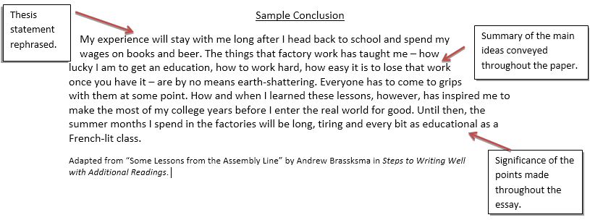

Slide 20
Social media influence on youth
Social media helps people connect with each other through time and space, share thoughts and impressions, congratulate on various occasions support each other when needed. That caused a massive globalization process and affected people from all over the world. And now it is time to limit the negative influence of Facebook and take responsibility for future generations.

Slide 21
What are the causes of homelessness?
Passing by a homeless person is not uncommon, especially in urban settings. Homelessness can be caused by many factors, including job loss, lack of family support, and the diminishing availability of affordable housing. Although it is easy for some to think that homelessness is caused by mental problems or general laziness, there are other factors to consider. Only when the whole scope of the problem is known can society begin to come up with a comprehensive solution.

Slide 22
For the broad topic ‘Gaming’ do the following
Narrow it down to a specific topic. (DO NOT WRITE A TOPIC SENTENCE)
Generate 10 points using the listing technique.
Write a 3 point thesis statement of the narrowed topic.
Write an Introductory paragraph (120 words).
an anecdote /short story/
Question
Factual Statement
Your paragraph should include
a readers hook;
a transitional sentence linking the reader’s hook to the thesis and
a three point thesis statement.

